Slide 1
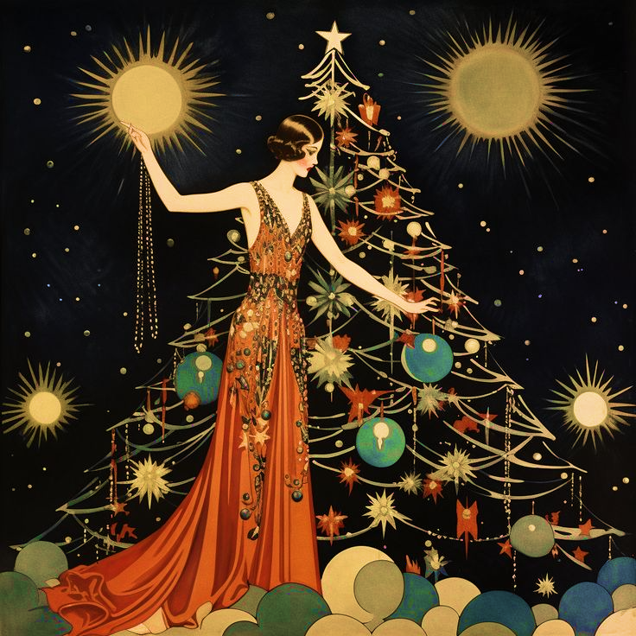

Christmas Collabs
圣诞活动线下合作方案
【线下商铺&萨福圣诞联动】
所涉品牌：萨福sappho X “”（具体酒吧合作方案会根据实际情况单独草拟，以下用tako作为案例示意）

Slide 2




一、品牌介绍与合作愿景 Brand Introduction and Collaboration Vision
在快速变化的新消费市场中，萨福是一个成立了近3年的女性身心愉悦的品牌 我们首次将身心安护的理念加入生活情趣产品当中 通过研发令女性安心使用且富于情绪价值的产品，提升女性生活中的愉悦与健康 我们也第 一个将女性视⻆带入计生用品行业的品牌。
In the rapidly changing new consumer market, Sappho is a brand that has been established for nearly three years, focusing on women's physical and mental well-being. We are the first to incorporate the concept of physical and mental care into lifestyle products, developing products that are reassuring to use and emotionally valuable, enhancing women's pleasure and health in daily life. We are also the first brand to bring a female perspective into the family planning products industry.

Slide 3
一、品牌介绍与合作愿景 Brand Introduction and Collaboration Vision
Offline bars, as popular venues for socializing and entertainment, are ideal platforms for brand parties to promote innovative lifestyle products, disseminate brand philosophy, and forge intimate connections with consumers. Based on our industry sector and brand tone, after inspecting offline physical bars in Shanghai, we eagerly hope to collaborate with offline women's bars during the important marketing period of [Christmas and New Year's Eve], hosting an offline event with strong influence and high exposure.
线下酒吧作为社交与娱乐的热门场所，对于品牌方来说，是推广创新生活方式产品、传播品牌理念以及亲密链接消费者的理想平台。根据我们所在领域以及品牌调性，在对上海线下实体商业酒吧的考察后，我们非常希望能够再【双旦】这个重要的营销节点，与线下女性酒吧达成一次具有较强影响力和较大曝光度的线下活动。

Slide 4

二、合作的目的与收益 Collaboration Goals and Benefits
Collaboration Goals and Benefits
品牌曝光：萨福希望通过线下活动，完成于消费者的最直接亲密触达，提升萨福在 目标消费群体中的知名度与品牌形象。
增加流量：TAKO酒吧重新开业，我们希望通过“萨福”的影响力，成就更多线上流量曝光以及线下流量销售。
提高声量：通过“国内指套天猫销量第一品牌”与“上海最大女性酒吧”的两方合作，实现影响力最大化；为TAKO提供强有力的官方品牌声量加持。
共创收益：通过创新的酒水分成机制，实现更深度的共赢合作。
Brand Exposure: Sappho aims to engage in direct and intimate interactions with consumers through offline events, boosting Sappho's recognition and brand image among the target consumer group.
Increased Traffic: TAKO Bar is reopening, and we hope to leverage the influence of "Sappho" to generate more online traffic exposure and offline sales.
Enhanced Voice: Through the collaboration between the ”Domestic first-ranking finger cot brand on Tmall" and "Shanghai's largest women's bar," we aim to maximize influence; providing TAKO with robust official brand support.
Joint Profit Creation: Achieving deeper mutual benefit through an innovative alcohol revenue-sharing mechanism.

Slide 5
三、合作优势 Collaboration Advantages
Brand Voice: Our finger cots feature novel designs and safe, comfortable materials, not only protecting fingers but also serving as fashionable accessories, seamlessly blending into the trendy atmosphere of the bar.
Cost-effectiveness: Considering your bar's cost considerations, we propose initiating a low-cost collaboration model, primarily achieving mutual benefit through alcohol revenue sharing.
Interactive Marketing: Providing customized marketing activity plans based on the theme of [Love on the Fingers] (details below), enriching online promotional content to attract platform traffic; enhancing offline customer engagement and boosting bar popularity.
Flexible Support: Providing product display stands, promotional posters, and other material support according to bar needs, along with joint online and offline promotion.
品牌声量：我们的指套设计新颖，材质安全舒适，不仅能保护手指，还能作为时尚配饰，完美融入酒吧的潮流氛围。
成本效益：考虑到贵酒吧的成本考量，我们提议以低成本的合作模式启动，主要通过酒水分成实现共赢。
互动营销：根据【真爱zhi上】主题提供 by case 的定制化营销活动方案（可见下文），线上提升宣传内容丰富度，吸引平台流量；线下增强顾客参与感，提升酒吧人气。
灵活支持：根据酒吧需求，提供产品展示架、宣传海报等物料支持，以及线上线下的联合宣传。

Slide 6

四、合作模式 Collaboration Models
（1）根据具体的酒吧合作模式进行讨论及合作方式选择，
确定方式后拟定针对某一合作的具体方案。
（2）后文中提到的6中合作方式都可以进行选择和叠加，具体按照酒吧需求与合作细则商定。

Slide 7
1. 品牌露出联合活动 Brand Exposure Joint Activities
a.线下展台合作
店铺提供并设置展台位，品牌方将相关产品展品（与店铺相关产品）共同在店内区域进行摆放、展示。
店铺展台位设置大的卡点，消费者品牌放相关账号，即可得到品牌方提供的店铺抽奖产品：兑换码+产品试用装（暂定）；
b.线上平台宣传
店铺官方与品牌官方在社交媒体平台进行联合活动宣传。
发起“打卡拍照【真爱zhi上】话题活动”，顾客发小红书艾特品牌方；参与品牌活动打卡线上抽奖赢礼品
a. Offline Exhibition Stand Collaboration:
The venue provides and sets up an exhibition stand, where the brand party will display relevant products alongside the venue's related products.
A large checkpoint is set up at the venue's exhibition stand. By following the brand's related account, consumers can receive a draw code and product sample (tentative) from the brand party.
b. Online Platform Promotion:
The venue's official account and the brand's official account jointly promote the event on social media platforms.
Initiate a "#Love on the Fingers Photo Check-in" topic activity, encouraging customers to post on Xiaohongshu and tag the brand party; participate in the brand activity check-in for online prize drawings.

Slide 8
2.品牌联合活动选项 Joint Activity Options
线下现场趣味活动
圣诞女巫派对——全女社群活动（拟定）
活动主题：【真爱ZHI上】游乐场
【真爱ZHI上】——“ZHI上”既是“至上”又是“指上”，既迎合“爱、快乐与浪漫”的圣诞氛围，又将酷儿、亚文化等小众女性群体的主体性纳入其中，创造一个独属于“一切离经叛道者”“一切第二性”的团聚时刻，创造我们的游戏、我们的圣诞，庆祝我们的爱情、我们的友谊、我们的团聚。
a. Live Fun Activities: (1) Christmas Witch Party - An All-Female Community Event (Proposed) Event Theme: [Love on the Fingers] Amusement Park Concept Interpretation:
[Love on the Fingers] - "Fingers" signifies both "supreme" and "on the fingers," catering to the festive atmosphere of "love, joy, and romance" during Christmas while incorporating the subjectivity of niche female groups such as queer and subcultures, creating a unique gathering moment for "all rebels" and "all second sexes," celebrating our games, our Christmas, our love, our friendships, and our reunions.

Slide 9
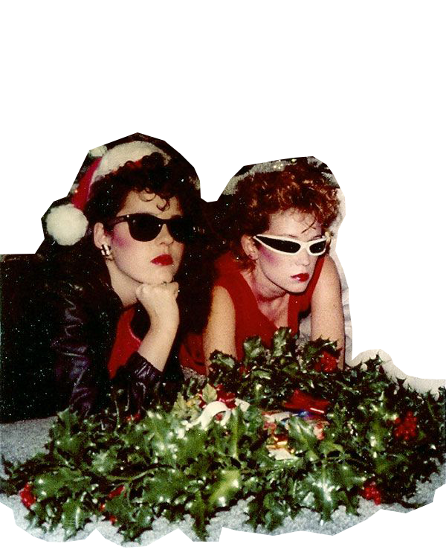
现场游戏互动方案 On-site Games and Interaction Plan:
真爱ZHI上——新的一年，干一杯继续爱人 女孩们的爱总是私密的、隐藏的，希望在这个活动中，可以将女性的爱“搬上台面”，不管是情侣还是单身女性，这个活动中大家可以看得到彼此，了解不同的感情模式、看到她人的故事，一起聊天、跳舞、饮酒，这里是安全的、自由的，“我们的节日”。
Love on the Fingers - In the new year, let's toast to continue loving each other. Girls' love is often private and hidden. We hope this event can bring women's love "out into the open." Whether in couples or single women, this event allows everyone to see and understand different emotional patterns and stories, chatting, dancing, and drinking together. It is a safe and free space, "our festival."

Slide 10
PART | CONTENT | TIME LINE
环节一 | 「拉拉拉呱开放麦」脱口秀活动，邀请圈内脱口秀人表演，并在双方媒体号开放报名。 | 20:00-21:00
环节二 | 萨福情侣卡牌游戏摊位（脱口秀后开放） 场地中开辟专门区域：使用萨福卡牌；可以任意邀请场内参与者进入专门区域进行游戏 参与方式：随进随参与，区域内有最多容纳人数限制 游戏内容：两人或者多人，针对萨福卡牌问题进行回答互动。增加场内互动社交 塔罗摊位（全场开放） 摊位内容：塔罗测算(塔罗师互勉或者费用平坦)；直女预测（针对下方游戏所设置的验证区）； 谁是直女游戏 主持人宣布游戏开始，入场期间直女需要隐藏身份。 电影放映区 （依场地设备而定） | 1:10- 22:10
PART | CONTENT | TIME LINE
Part 1 | "Chat Open Mic" stand-up comedy performance, inviting performers from within the circle and opening registration on both parties' media accounts. | 20:00-21:00
Part 2 | Sappho Couples Card Game Stall (opens after stand-up comedy) A dedicated area is set up in the venue: using Sappho cards; participants can invite anyone in the venue to enter the dedicated area for games. Participation mode: open entry with a limit on the maximum number of people in the area. Game content: two or more people answer and interact based on Sappho card questions. Interactive Tarot Stall (open throughout the venue). Stall content: tarot readings (tarot readers exchange services or share costs); Straight Girl Prediction (for the verification area set up for the following game); Who's the Straight Girl? The game host announces the start of the game, and straight girls need to hide their identities during entry. Movie Screening Area (depending on venue equipment) | 1:10- 22:10

Slide 11

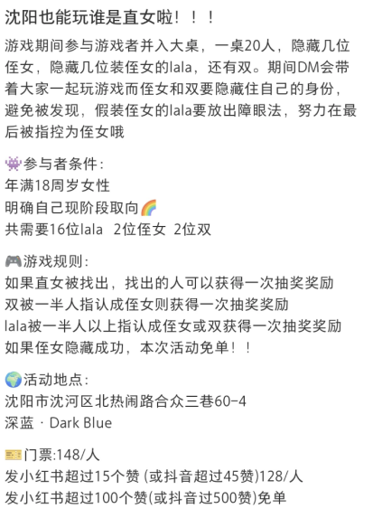
PART | CONTENT | TIME LINE
环节二 |  | 20:00-21:00
环节三 | 「音乐与酒自在舞」舞池蹦迪活动，靠近午夜进行，给女孩们一个安全自由的锐舞空间。 | 22:00-
PART | CONTENT | TIME LINE
Part 2 |  | 20:00-21:00
Part 2 | "Music and Drink, Free Dance" dance floor disco event, held near midnight, providing girls with a safe and free dance space. | 22:00-

Slide 12
3. 特别互动 Special Interaction
好东西电影拍立得打卡互动（是否需要得到电影 发行方支持？--可以自发/看线下酒吧是否想融合）
尝试与《好东西》电影联名，场地张贴电影金句海报吸引顾客打卡，强调女性现实主义内涵，
“月经怎么了？这世界上有一半的人都在流血”
“要给年轻人机会”
“我正直、勇敢、有阅读量，我有什么可怜的？”
“我们不玩他们的游戏了，我们建立新的游戏规则”
“礼貌不会破坏氛围，不礼貌才会”等。
场地专属tag：#萨福好东西
“Good Stuff”“好东西” Movie Polaroid Photo Check-in Interaction
Attempt to collaborate with the "Good Stuff" movie, displaying movie quote posters around the venue to attract customers for photo check-ins, emphasizing female realism,
"What's wrong with menstruation? Half of the world's population bleeds.”
"Give young people a chance.”
"I'm upright, brave, and well-read. What's pitiful about me?" "We're not playing their game anymore. We're setting new rules.”
"Politeness doesn't ruin the atmosphere; impoliteness does." etc.
Venue exclusive hashtag: #SapphoGoodStuff #萨福好东西

Slide 13
4. 活动限定联名单品 Events-exclusive collaborative products
特殊酒单合作：店铺根据”真爱zhi上“主题，以及萨福品牌与酒吧调性设计“限定酒单/单品”
品牌方可以根据特殊酒单/单品，附赠产品体验装，完成为”酒+产品”的活动限定
Special Drink Menu Collaboration: The venue designs an "exclusive drink menu/product" based on the theme of "Love on the Fingers," aligning with Sappho's brand and bar tone.
The brand party can attach product samples with special drink menus/products, completing the event-exclusive "drink + product" combination.

Slide 14
5. 现场满足一定条件，获得酒吧消费优惠券 Onsite conditions for bar consumption discounts
品牌方在酒吧设置打卡位，完成条件即可获得酒吧优惠券/品牌赠品/品牌消费券/其他优惠
顾客购买指定酒水或参与互动活动可获得优惠券或折扣，用于酒吧内消费。
The brand party sets up check-in points at the bar, where customers can receive bar coupons/brand gifts/brand consumption vouchers/other discounts by meeting certain conditions.
Customers can obtain coupons or discounts for in-bar consumption by purchasing designated drinks or participating in interactive activities.

Slide 15
6. 消费满一定金额，可得品牌方「圣诞礼包」 Consumption over a certain amount for Brands {Christmas gift bag}
可商议具体金额；品牌圣诞礼包策划中
Specific amounts can be negotiated; the brand's Christmas gift bag is under planning.

Slide 16
五、合作收益 Collaboration Benefits
萨福希望通过收益分成的方式，更好的促进双方合作氛围与深入合作承诺。
若单独采用【活动限定联名酒水】方案，就活动当晚【单品】销售数据进行一定比例分成。期望比例10%
若达成活动方案，希望针对通过萨福联名活动带来的活动当晚销售数据进行一定比例分成。期望比例5%。
结合上述两种方案，根据活动效果和市场反馈灵活调整分成比例和规则。
Sappho hopes to better promote the cooperation atmosphere and deepen commitment through a revenue-sharing approach.
If only the [Event-exclusive Collaborative Drink] scheme is adopted, a certain percentage of the sales data for that evening's [product] will be shared. Expected percentage: 10%.
If the entire event plan is implemented, we hope to share a certain percentage of the sales data for that evening brought by the Sappho collaborative event. Expected percentage: 5%.
Combining these two schemes, the revenue-sharing percentage and rules will be flexibly adjusted based on event performance and market feedback.

Slide 17
六、执行步骤 Implementation steps
初步沟通：双方确认合作意向，明确合作细节。
物料准备：品牌方负责制作并提供所需宣传物料，包含线上线下。酒吧协助准备产品展示架、宣传物料支持。
现场布置：品牌方在活动前与酒吧进行前置活动布置。
Initial Communication: Both parties confirm the intention to collaborate and clarify the details of the collaboration.
Material Preparation: The brand party is responsible for producing and providing the required promotional materials, including both online and offline. The bar assists in preparing product display stands and promotional material support.
Onsite Arrangement: The brand party conducts pre-event setup with the bar.

Slide 18
六、执行步骤 Implementation steps
活动执行：按计划开展合作活动，线上线下的联合宣传支持，包括社交媒体内容创作、广告投放等。
效果评估与结算：合作结束后，根据销售数据进行分成结算，并评估合作效果，探讨后续合作可能。
Event Execution: Carry out the collaborative activities as planned, with joint online and offline promotional support, including social media content creation, advertising placements, etc.
Effectiveness Evaluation and Settlement: Upon completion of the cooperation, the settlement will be conducted based on sales data, the cooperation effectiveness will be evaluated, and potential for future collaboration will be discussed.

Slide 19
Merry Christmas!
期待与您的合作

